Slide 1
Stock market anaysis
Machine learning and Neural Network assignment
Team Members :
Roshan Richard Dinesh
Mukesh Avudaiappan
Saranya Bala Subramaniam
Anju Mahesh
Aleena Arakal Joshy

Slide 2
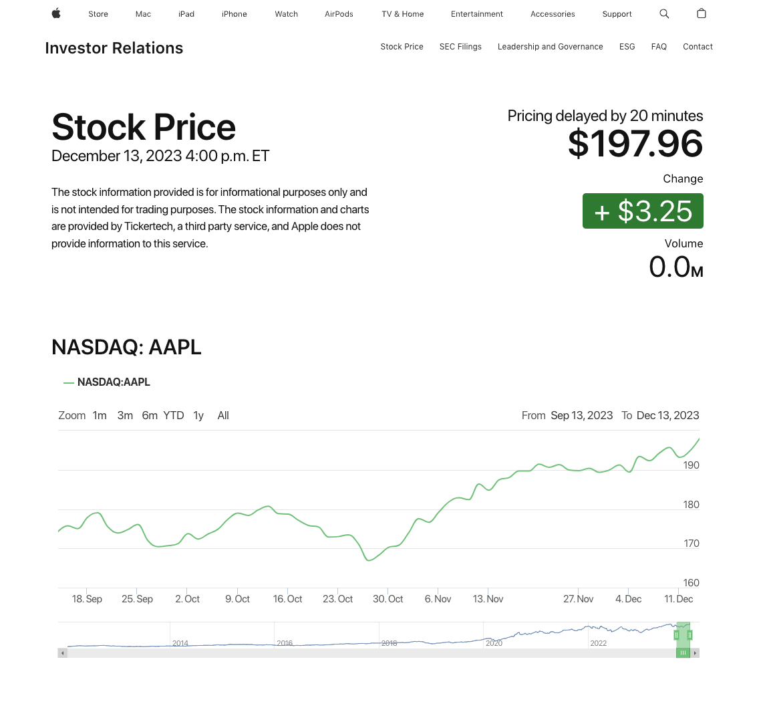
Introduction to chosen stock:
Hello there, This is an presentation regarding analysis of stock data, focusing on stocks of Apple Inc [AAPL].
This business is significant in the industry because of its Product innovation, a powerful worldwide brand, and the smooth integration of services, software, and hardware within its ecosystem are the three main factors driving Apple's success. Revenue growth is facilitated by a focus on growing services and the release of important products like the Mac and iPhone.
Investor trust is further bolstered by the company's strong financial performance, worldwide market presence, and steady return of shareholder value through dividends and buybacks. Consumer trends and the state of the economy are also important factors. Apple's success is frequently attributed to its capacity to adjust to shifting market conditions and preserve its competitive advantage in the technology industry.
Our goal is to leverage advanced machine learning techniques, specifically LSTM models, to predict and analyse stock prices

Slide 3
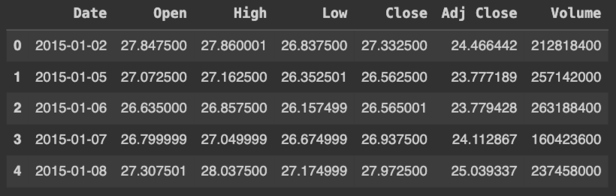
Data
In this project the data of the stock prices of the company named Apple of which the symbol AAPL was extracted using an python module named yfinance.
The data contains the Date, Open, High, Low, Close, Adj Close and Volume
The main data that is required for the model is Date and Close price
Fig: 1.0
The extracted data ranges between 2015-0-01 to 2022-12-31

Slide 4
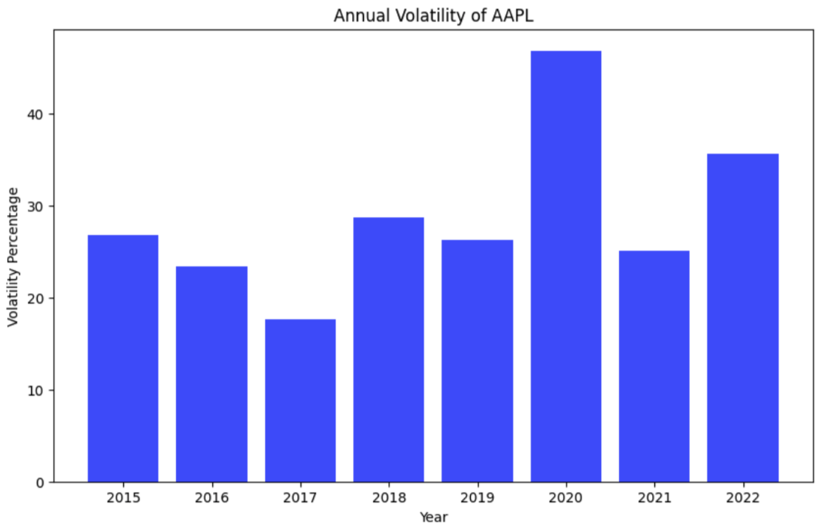
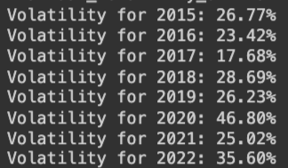
Volatility of the stock data:
The data we extracted has the stock data of the past 8 years. The program checks the volatility of the stock price each year and returns it in an percentage format.
The Fig 1.1 is an representation of the volatility each year in an bar chart
The Fig 1.2 is the output printed by the code which has the volatility percentage of each year
To determine whether the stock is less or more volatile we use this separation method:
If Volatility is less than 20 the stock is less volatile
If Volatility is more than 20 and less than 35 the stock is mid volatile
If Volatility is more that 35 then the stock is High volatile
Fig 1.1
Fig 1.2

Slide 5
oVerview of lstm’s for stock data:
Introduction to lstm’s:
Long Short-Term Memory [LSTM] are a type of Recurrent Neural Network [RNN] that are made to handle and analyse sequential data
The capacity of LSTMs to retain information over longer periods of time and identify long-term dependencies is what makes them unique.
Why is lstm’s used for stock analysis:
Temporal Patterns: Traditional models may find it difficult to explain the complex temporal patterns that stock values display.
Memory Mechanism: LSTMs are perfect for forecasting stock movements since they are good at recognising patterns over time.
Sequential Relationships: The sequential structure of stock data, in which past prices impact the present price, is consistent with LSTMs' strong points.
Why is lstm’s used for stock analysis:
Long-Term Dependencies: LSTMs are capable of capturing connections between events that are separated by a large amount of time.
Avoiding Vanishing Gradient: Long Short-Term Memory (LSTM) models solve the vanishing gradient issue, enabling the retention of data across multiple time steps.
Flexible Input Handling: Because stock price data is dynamic, LSTMs may accommodate variable-length sequences.

Slide 6
Preprocessing techniques USed:
Moving on to the preprocessing techniques the techniques we employed to prepare our data for the LSTM model are:
Normalization: We normalized the stock prices using Min-Max scaling to ensure all values are in the range between 0 and 1.
Reshaping: The data was reshaped into a 3D array, which is the suitable input requirement for our LSTM model.
Splitting Data: We divided the dataset into training which is the first 80 percent of the dataset and testing sets which is the last 20 percent of the dataset to evaluate our model effectively.
Inverse Transform: Predictions were inverse transformed to the original scale for meaningful interpretation.
These techniques are crucial for optimizing the model’s performance and ensuring it can effectively learn from the data.

Slide 7



Visual representation of how lstm works:
For example let us assume that we have an array of sequential data. The data is divided into two parts and the first part is used to train the model and the second part is used predict the next coming values by the below method. LSTM single layer model below uses the first five values to predict the sixth value
1
2
3
4
5
6
When the sixth value is obtained the last five value of the sequential array is used to obtain the 7th value
1
2
3
4
5
6
7
Likewise the process goes on and on
1
2
3
4
5
6
7
8

Slide 8
The lstm architechture and the chosen parameter:
Now lets delve into the architecture of the LSTM model and the parameter chosen
Architecture Overview:
Our LSTM model is made with simplicity and effectiveness in mind.
It consists of a single LSTM layer, a key component for capturing temporal dependencies in sequential data.
Following the LSTM layer, we have a Dense layer responsible for producing the output.
Parameter Chosen:
The number of units in the LSTM layer that we chose was fifty. This decision finds a balance between computing efficiency and model complexity.
Activation Function: In the LSTM layer, the activation function is the Rectified Linear Unit (ReLU). ReLU's capacity to identify non-linear relationships in data makes it a popular choice.
Input Shape: The amount of time steps and features in our dataset influence the input shape.
Consideration for Model Interpretability:
Interpretability is given top priority in the selected architecture, which enables efficient analysis and comprehension of the acquired patterns.
We'll examine the findings and forecasts from our LSTM model in the following section, providing insight into how well it predicts stock prices for the company Apple. Let's move on to the results in the following slide.

Slide 9
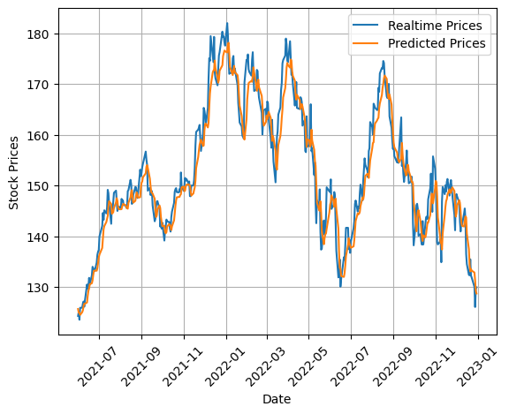
Results and predictions:
The Result obtained from the predicted values of our model is quite similar to the Realtime values as shown in Fig: 1.3
The data we extracted was from 2015-0-01 to 2022-12-31 in which the first 80% of the data was feed into the model for training it and the prediction was made only for the remaining 20% of the data
With the use of actual stock prices on the test set, we observed
and predicted the rest of the values
Fig: 1.3

Slide 10
Limitation and conclusion
The truth is no one can predict the stock price with full accuracy because the value of the stock depends on numerous factors and everything cannot be calculated.
But you may wonder that our result our program is similar to the actual stock price. Its similar because we used an single step forecasting in this project but what we want is an multistep forecasting but can predict the actual stock price but as already said if we apply multi-step forecasting the predicted values will move there move away drastically from the actual value
The goal of the project is to show how the LTSM models work.

